Slide 1

CoBot - The Carbon Trade Ally Domain: AI
Final Review
Course Code: CS7610
Course Title: Capstone Project
Guide Name: Shiyamala Gowri G
Register Number: 24MSP3070
Name: DHARSHINI M
Date: June 20, 2025

Slide 2
Abstract
An AI-powered chatbot called CoBot—The Carbon Trading Ally—was created to make carbon trading easier for people, businesses, and legislators. CoBot, which was developed using a Retrieval-Augmented Generation (RAG) framework, analyses PDF documents pertaining to carbon, embeds them using Google Generative AI, and uses FAISS vector search to find pertinent context. Through a conversational interface created in Streamlit, the system provides real-time answers to queries and provides expert-level advice on compliance, credits, and market trends. CoBot currently uses a small dataset of four important documents, but it intends to integrate more market and government resources in order to increase its knowledge base. This project serves as an example of how AI can advance policy literacy, climate awareness, and data-driven sustainability decision-making.
Keywords: Carbon Trading, RAG, FAISS, Google GenAI, Chatbot, Streamlit, Sustainability, Climate Intelligence

Slide 3
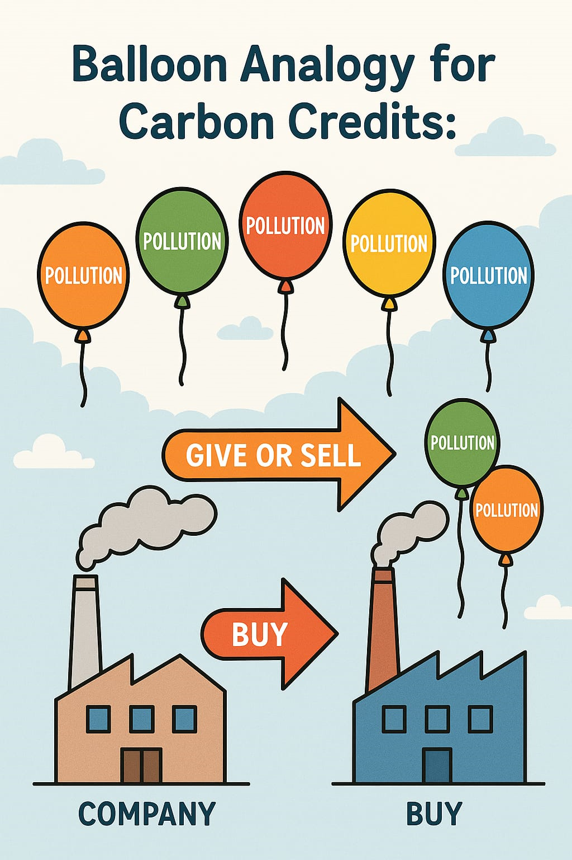
INTRODUCTION What are Carbon Credits?
1 Carbon credit = 1 tonne of CO₂ (or equivalent greenhouse gas)
Cap-and-Trade Systems: Governments or regulators set a limit (cap) on total emissions. Companies receive or buy credits; if they emit less, they can sell excess credits.
Voluntary Markets: Companies/individuals buy credits to voluntarily offset emissions (e.g., for CSR goals).
Projects Behind Credits:
Fund initiatives like:
Renewable energy (solar/wind farms).
Reforestation.
Methane capture (e.g., from landfills).
Benefits:
Cost-Effective: Cheaper than fines for exceeding emission limits.
Sustainability: Funds green projects.
Market Transparency: Encourages accountability via trading platforms.

Slide 4
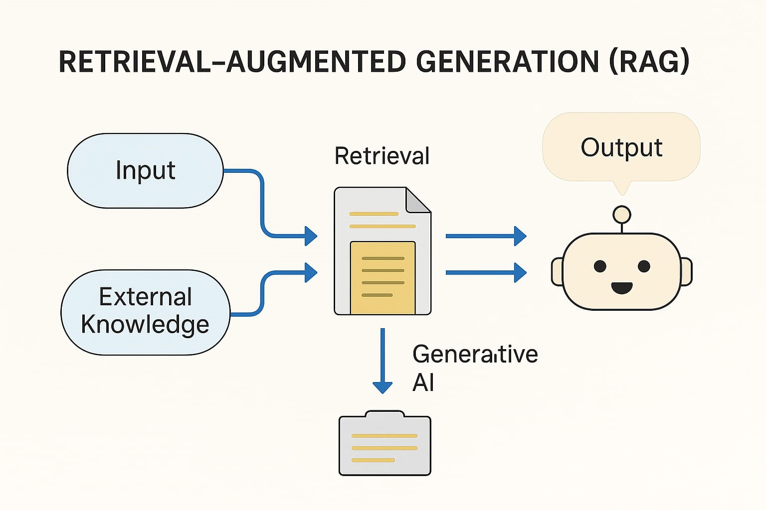
RAG - Basic Working Explained
1. User Input : A user asks a question.
2. Retrieval Step:
The system searches a collection of documents or knowledge sources (like PDFs, websites, or databases).
It picks the most relevant information related to the question.
3. Generative Step:
The generative AI reads the retrieved content.
It creates a new, natural-sounding answer using that information.
4. Final Output:
The chatbot shows the user a well-informed and accurate response.

Slide 5
Need of Study
Climate change requires urgent and well-informed actions from all sectors.
Carbon trading is a complex mechanism involving policies, pricing, and verification.
Many individuals and organizations lack accessible guidance on carbon markets.
Critical information is often buried in lengthy, technical documents.
There is a gap in tools that provide real-time, accurate answers about carbon trading.
AI-powered systems can help simplify complex data and improve decision-making.
CoBot addresses this gap by offering an intelligent, user-friendly solution for carbon trading support.

Slide 6
Problem Statement
CARBON TRADING QUERIES: CoBot is aimed at giving users instant, precise answers to carbon trading questions, ranging from general to real-time queries.
MARKET INSIGHTS AND ANALYTICS: The system utilizing AI provides real-time information regarding the carbon trading market based on current data and information.
RETRIEVAL-AUGMENTED GENERATION (RAG) TECHNOLOGY: Using RAG-based architecture, the chatbot leverages the strength of document retrieval and generative AI models to offer responses. It retrieves substantial information from a given collection of documents and creates informative, accurate, and contextually relevant responses.
AI-DRIVEN ASSISTANCE FOR CARBON MARKET PARTICIPANTS: Regardless of if it is an individual, organization, or a government, the chatbot is a trustworthy source of information for stakeholders of the carbon trading market, facilitating decision-making, compliance with regulations, and knowledge of the environmental and economic implications of carbon trading.

Slide 7
Objectives
Instant Answers
Provide quick and accurate responses to carbon trading questions.
Market Insights
Offer real-time trends and analytics using AI.
RAG-Based Intelligence
Combine smart document retrieval with generative AI for reliable information.
Informed Decisions
Support individuals, businesses, and policymakers in making smart choices.
Sustainable Participation
Encourage transparency and responsibility in the carbon trading ecosystem.

Slide 8
Review of Related Literature
Base Paper
CarbonChat: Large Language Model-Based Corporate Carbon Emission Analysis and Climate Knowledge Q&A System
Cao, Z., Han, M., Wang, J., & Jia, M. (2025). CarbonChat: Large Language Model-Based Corporate Carbon Emission Analysis and Climate Knowledge Q&A System. https://doi.org/10.48550/arxiv.2501.02031

Slide 9
Review of Related Literature Comparison of base paper with my work
Title of the Paper | Authors | Journal Name/Conference Title & Publisher | Year of Publication | Methodology Used | Outcome | Limitations of the Research | Points Taken into Consideration for Methodology
CarbonChat: Large Language Model-Based Corporate Carbon Emission Analysis and Climate Knowledge Q&A System | Cao, Z., Han, M., Wang, J., & Jia, M. | arXiv (Preprint) | 2025 | Retrieval-Augmented Generation (RAG) with LLMs using carbon datasets, embeddings, and prompt engineering. | Developed a chatbot system that answers corporate carbon emission questions with a knowledge base. | Dataset limited to corporate reports, not real-time data; complex queries require manual curation. | Importance of document chunking, embedding models, and fine-tuning for climate-specific context.
CoBot – The Carbon Trade Ally | Dharshini M | Academic Project | 2025 | Interactive RAG-based LLM system using FAISS, Google Generative AI embeddings, and multi-PDF vector retrieval. | Real-time chatbot offering answers to carbon trading queries, market trends, and decision support. | Real-time accuracy depends on uploaded documents; limited to scope of documents provided. | Focused on fast PDF parsing, embedding quality, relevance-based retrieval, and Gemini-pro generation.

Slide 10
Review of Related Literature
Title of the Paper | Authors | Journal Name/Conference Title & Publisher | Year of Publication | Methodology Used | Outcome | Limitations of the Research | Points Taken into Consideration for Methodology
Efficiency-Driven Custom Chatbot Development: Unleashing LangChain, RAG, and Performance-Optimized LLM Fusion | Vidivelli, S., Manikandan, R., & Dharunbalaji, A. | CMC-Computers, Materials & Continua | 2024 | LangChain-based RAG pipeline with optimized embedding and prompt engineering. | Built a fast, efficient custom chatbot with improved latency and performance. | Focused only on framework speed, less on domain-specific accuracy. | Chose LangChain for modular design, and optimized chunk size and model latency.
Carbon Trading | Raymond, L. | Edward Elgar Publishing (Book Chapter) | 2024 | Conceptual and economic analysis of carbon trading markets. | Provided in-depth understanding of global carbon market principles and mechanisms. | Theoretical in nature; lacks practical AI application or implementation. | Highlights market challenges, compliance, and trading flows useful for designing query datasets.

Slide 11
Review of Related Literature
Title of the Paper | Authors | Journal Name/Conference Title & Publisher | Year of Publication | Methodology Used | Outcome | Limitations of the Research | Points Taken into Consideration for Methodology
LLM and RAG Powered Chatbot for the College of Computer Science and Mathematics at the University of Mosul | Mustafa, B. S., & Madhi, Y. E. | International Research Journal of Innovations in Engineering and Technology | 2024 | RAG framework with LangChain and LLM to support internal academic queries. | Created a local domain-specific chatbot for university-related queries. | Limited scope and performance optimization; not generalized to other sectors. | Demonstrates effectiveness of using RAG in restricted academic environments.
Preventing the Immense Increase in the Life-Cycle Energy and Carbon Footprints of LLM-Powered Intelligent Chatbots | Jiang, P., Sonne, C., Li, W., You, F., & You, S. | Engineering (Elsevier) | 2024 | Life-cycle assessment (LCA) methodology on LLM-powered chatbots. | Identified energy and carbon costs of deploying intelligent LLMs. | Does not offer direct solutions to reduce footprint. | Emphasizes the need for lightweight, low-energy chatbot architectures.

Slide 12
Dataset
Source of the dataset
https://www.ey.com/content/dam/ey-unified-site/ey-com/en-in/insights/sustainability/images/ey-carbon-trading-an-emerging-commodity-class.pdf
https://iklim.gov.tr/db/turkce/haberler/files/State%20and%20Trends%20of%20Carbon%20Pricing%202024-Full%20Report.pdf
https://openknowledge.worldbank.org/server/api/core/bitstreams/b98160d9-ca19-4a75-ad69-4b1d9e9319e3/content
https://www.esma.europa.eu/sites/default/files/2024-10/ESMA50-43599798-10379_Carbon_markets_report_2024.pdf

Slide 13
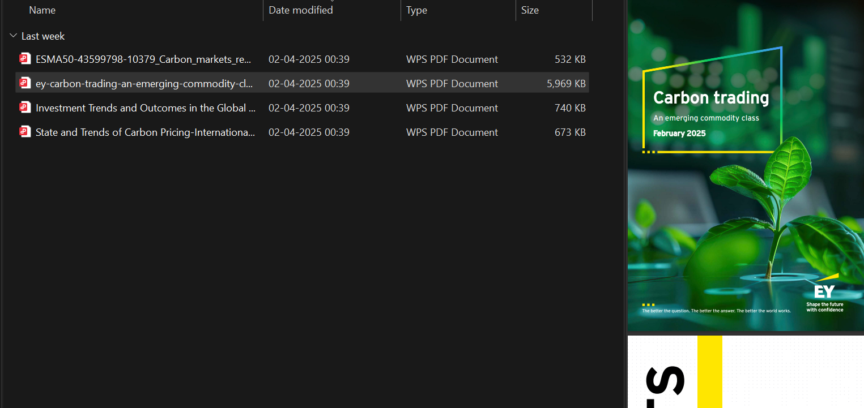
Screenshot of the dataset

Slide 14
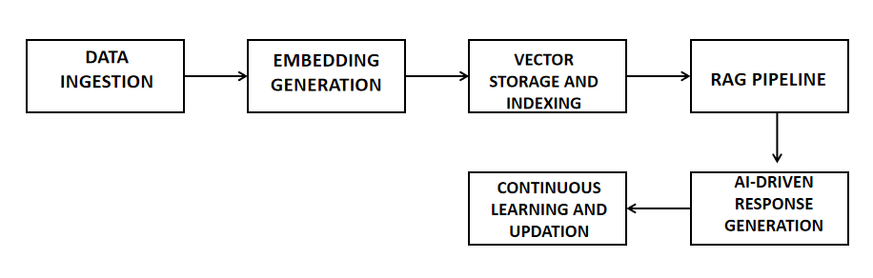
Proposed Methodology - Architecture Diagram

Slide 15
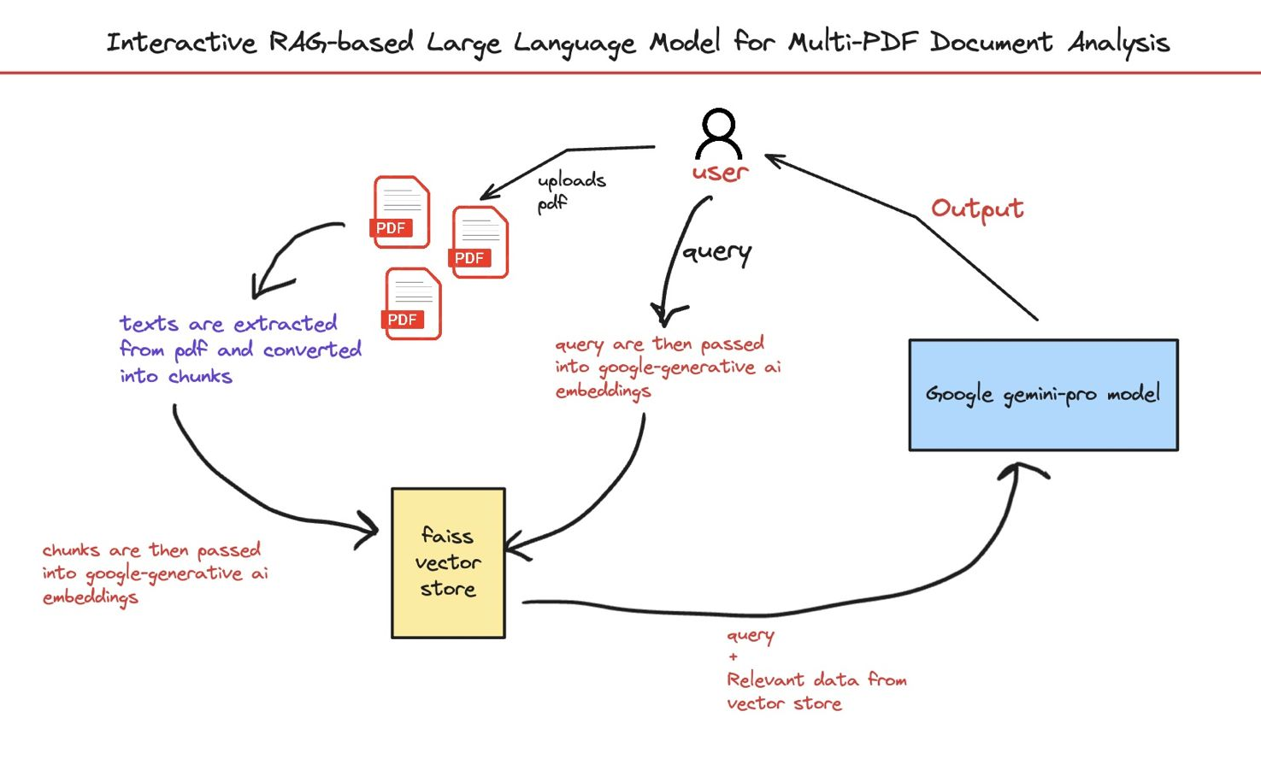
Proposed Methodology - Working Flow

Slide 16
Proposed Methodology
STEP 01: DATA INGESTION:
Users input applicable carbon trading documents (PDFs, reports, regulations, so on..).
The system breaks down into text chunks and processes them efficiently.
STEP 02: EMBEDDING GENERATION:
The text chunks are transformed into vector embeddings by Google Generative AI Embeddings.
The embeddings preserve semantic meaning for enhanced retrieval.
STEP 03: VECTOR STORAGE AND INDEXING:
FAISS (Facebook AI Similarity Search) stores the vectorized chunks of documents.
It supports quick similarity search in case queries are requested.

Slide 17
Proposed Methodology
STEP 04: QUERY PROCESSING:
Users provide queries on carbon trading laws, market trends, and analytics.
The query is also transformed into an embedding and matched with saved vectors in FAISS.
STEP 05: RETRIEVE-AUGMENTED GENERATION (RAG) PIPELINE:
Relevant data is fetched from the FAISS vector store.
The query and fetched context are sent to the Google Gemini-Pro Model to create a correct, context-specific response.

Slide 18
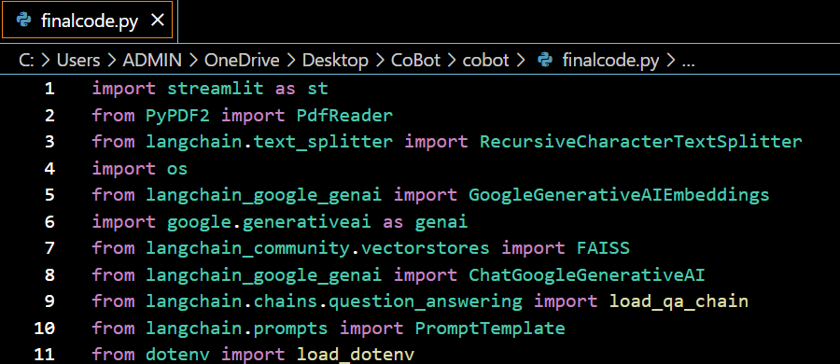
Libraries used:
Library | Purpose
streamlit | Builds the user interface for the chatbot web app
PyPDF2 | Reads and extracts text from PDF documents
RecursiveCharacterTextSplitter | Splits long text into smaller chunks for better understanding
os | Handles file paths, folder access, and saving/loading data
GoogleGenerativeAIEmbeddings | Converts text into vector embeddings for semantic search
google.generativeai | Connects to and configures Google’s Gemini AI model
FAISS | Stores and searches embeddings quickly using similarity search
ChatGoogleGenerativeAI | Sends questions and context to Gemini for generating answers
load_qa_chain | Combines retrieval and response generation into a question-answering chain
PromptTemplate | Designs a prompt to guide Gemini’s answers based on specific instructions
load_dotenv | Loads API keys securely from a .env file to keep them hidden

Slide 19
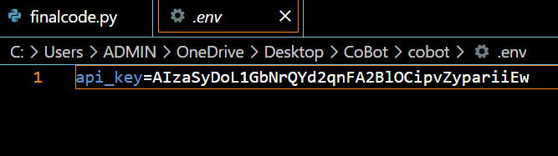
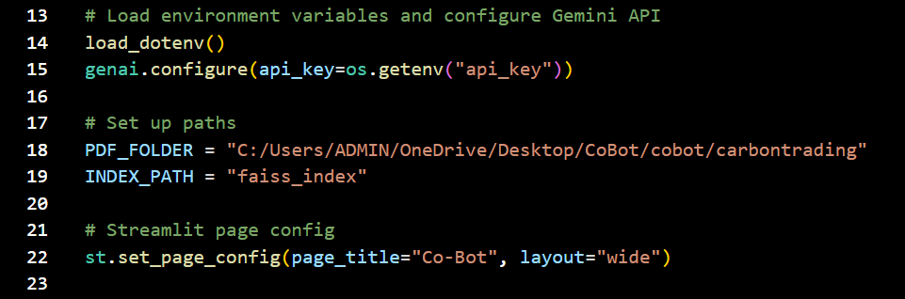
Program done and explanation:
load_dotenv()
Loads environment variables from a .env file.
Used to keep sensitive data like API keys safe and out of code.
genai.configure(api_key="...")
Initializes Google Generative AI with your API key.
Allows access to Gemini models (e.g., for embeddings or chat).
PDF_FOLDER = "C:/.../carbontrading"
Sets the file path where all your PDFs for CoBot are stored.
These PDFs are the knowledge source for your chatbot.
INDEX_PATH = "faiss_index"
Defines the local folder where the FAISS vector index will be saved.
This index is used for semantic search on embedded chunks of PDF content.
st.set_page_config(page_title="Co-Bot", layout="wide")
Configures the appearance of your Streamlit web app.
page_title → Sets browser tab title to “Co-Bot”.
layout="wide" → Uses full screen width for a more spacious UI.

Slide 20
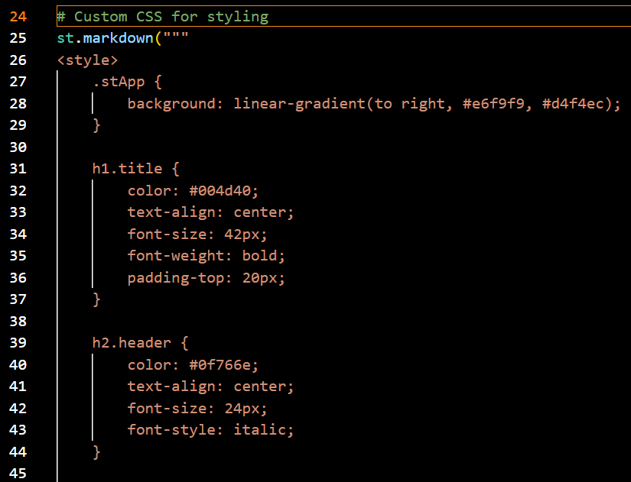
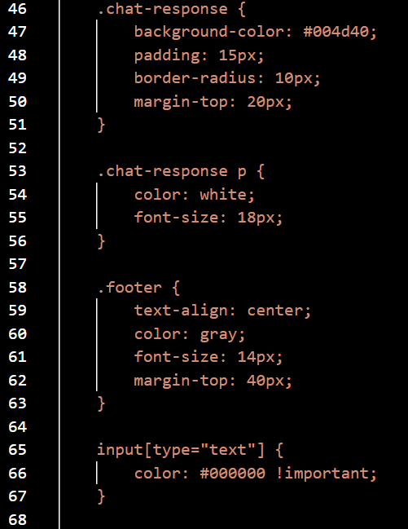
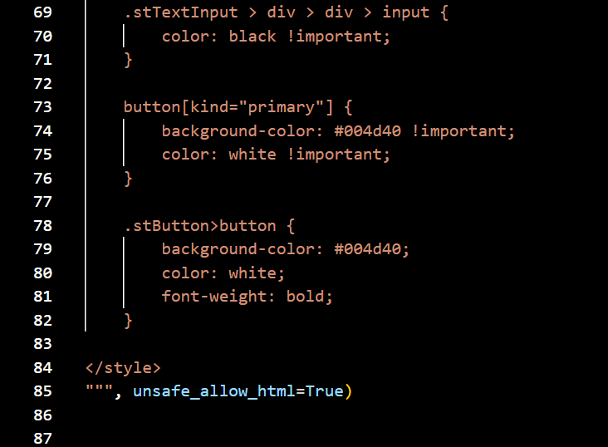
Program done and explanation:
Background Theme
Applies a soft teal gradient background (#e6f9f9 → #d4f4ec) across the app.
App Title & Header
Title (h1.title) is dark green (#004d40), bold and centered.
Subtitle (h2.header) is teal (#0f766e), italic and centered.
Chat Response Box
Background is dark green (#004d40) with white bold text.
Styled as a chat bubble with padding and rounded corners.
Text Input
Ensures user input text is visible in black (color: black !important).
Button Styling
Buttons are dark green with white bold text, overriding Streamlit’s default.
Footer
Footer text is gray, small, and center-aligned.

Slide 21
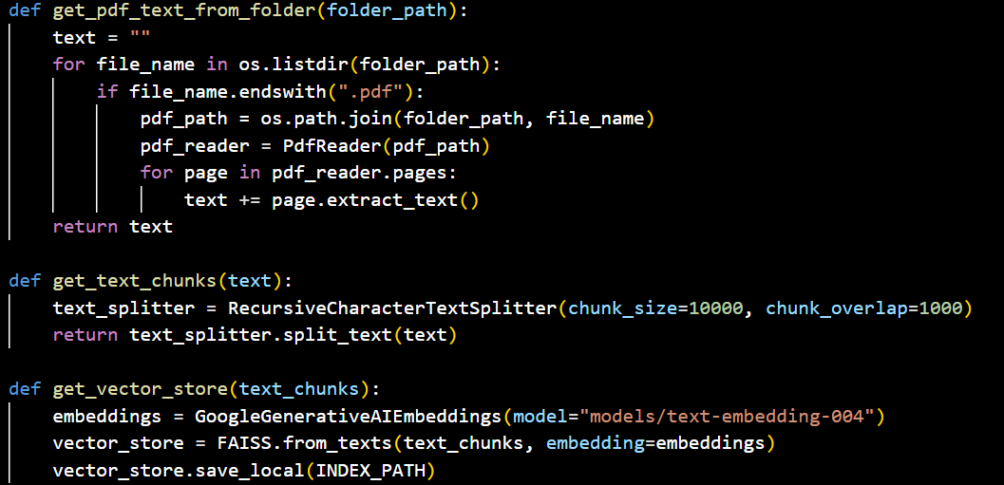
Program done:

Slide 22
Data Preprocessing - Program explanation
1. PDF Reading (Data Ingestion)
Function: get_pdf_text_from_folder(folder_path)
All uploaded PDF documents (carbon trading-related) are read using PdfReader.
Text is extracted page by page and combined into one large string.
Why? So the bot can understand and process real documents like policies and reports.
2. Text Splitting (Chunking)
Function: get_text_chunks(text)
The long text is broken down into smaller chunks using RecursiveCharacterTextSplitter.
Each chunk is about 10,000 characters, with some overlap for better context.
Why? Long texts are hard for AI to manage at once, so chunking helps it remember important details while keeping it manageable.
3. Vector Embedding Generation
Function: get_vector_store(text_chunks)
Each chunk is converted into vector embeddings using GoogleGenerativeAIEmbeddings.
These vectors capture the semantic meaning (not just words, but what they mean).
Then they're stored using FAISS, a fast similarity search engine.
Why?The AI can now search and match your future questions with the most relevant chunks of text.

Slide 23
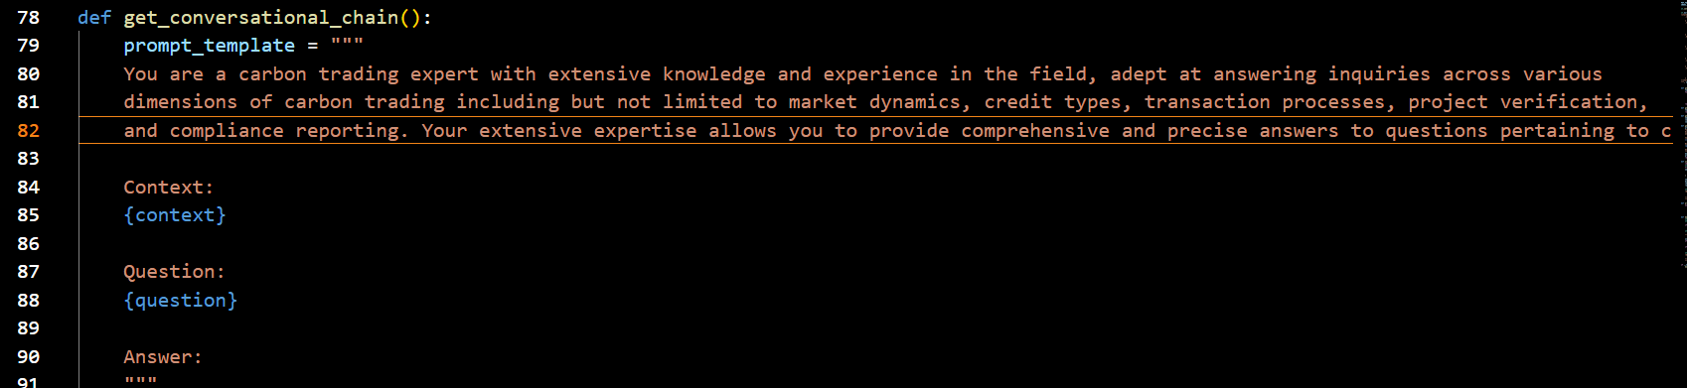
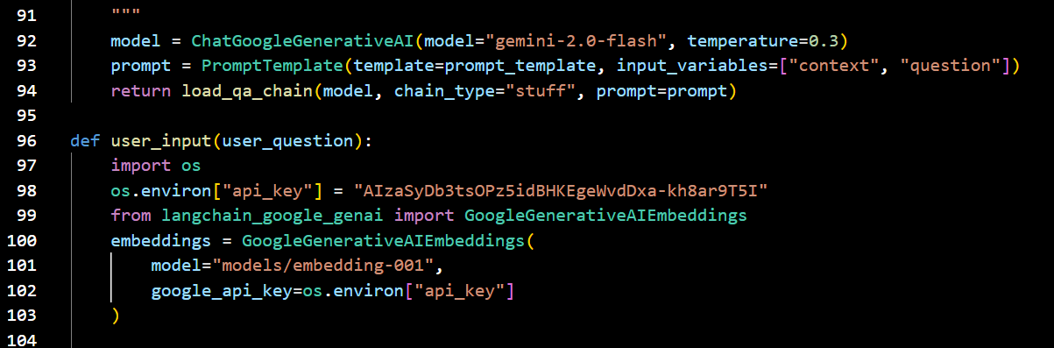
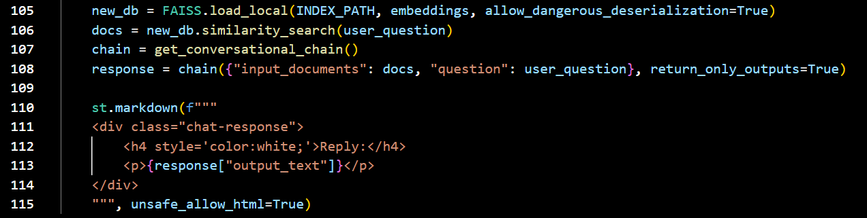
Program done and explanation:
Step | Description
🧠 Prompt | Makes the model act like a carbon trading expert.
📤 Input | Takes user query, prepares embeddings & search.
📚 Retrieval | Uses FAISS to find relevant PDF chunks.
🤖 Generation | Uses Gemini AI to generate an answer using retrieved docs.
💬 Display | Shows the result in a styled chat bubble via Streamlit.

Slide 24
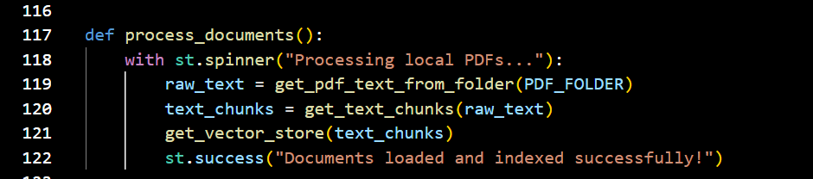
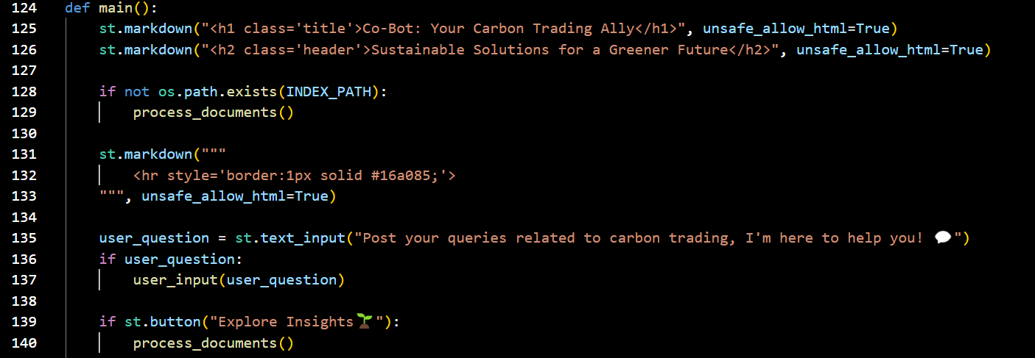
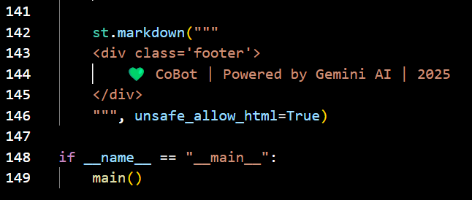
Program done:
Section | Function
process_documents() | Loads, splits, embeds PDF text
main() | Renders UI, processes input, controls app flow
.text_input() | Accepts user queries
"Explore Insights" button | Re-indexes document data
Footer | Shows branding info
Entry point | Ensures script runs only if executed directly

Slide 25
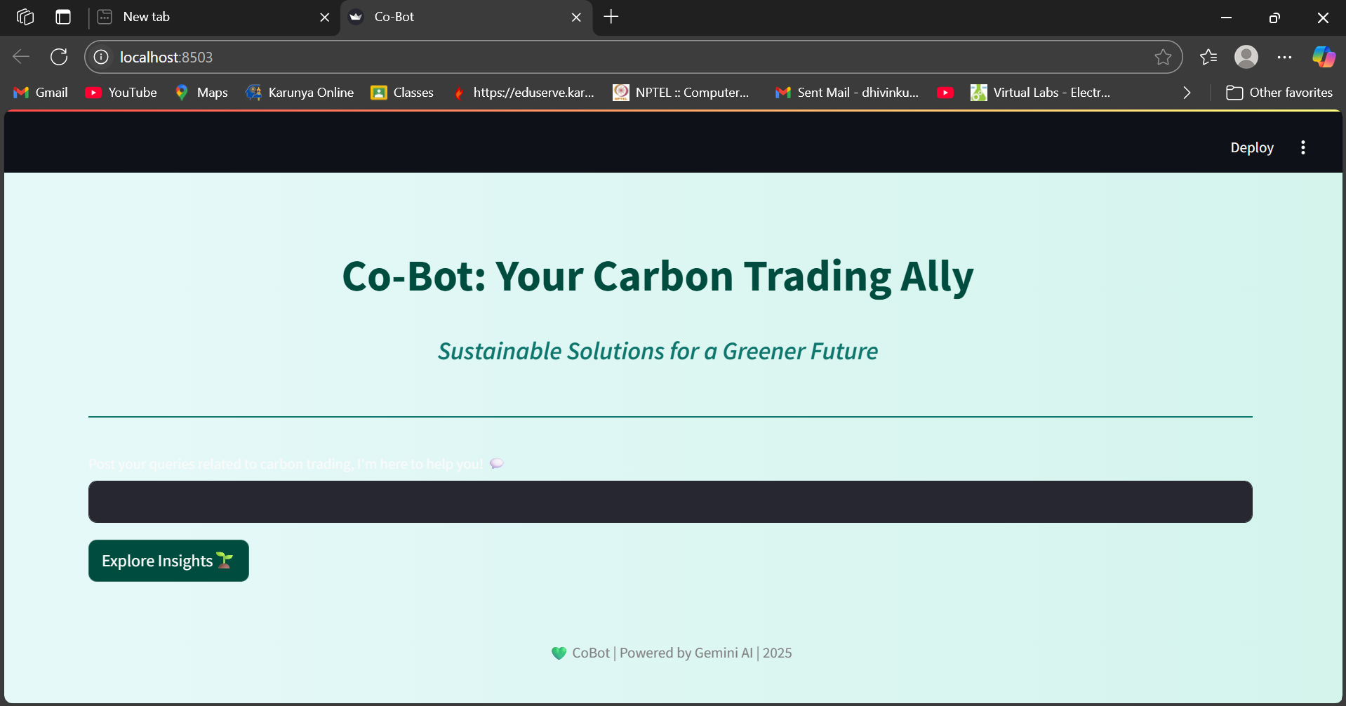
Results and Discussion:
The CoBot system successfully processes PDF documents and retrieves context-aware responses using RAG architecture.
Real-time question answering is enabled through FAISS-based similarity search and Gemini AI model integration.
The Streamlit interface allows users to interact with the system seamlessly through natural language queries.
Accurate responses were observed for a wide range of queries related to carbon credits, market pricing, and compliance norms.
Current limitations include a restricted dataset of only four PDFs, which may affect the depth of some responses.
The system demonstrates strong potential for scalability by adding more documents and live data sources.
CoBot proves the feasibility of using AI-driven tools to support sustainability education, market participation, and policy compliance.

Slide 26
Performance analysis:
Response Accuracy: For the majority of document-based queries, the generated responses are accurate and contextually relevant.
Retrieval Efficiency: FAISS vector search allows for nearly instantaneous responses by retrieving pertinent chunks in milliseconds.
Model Reliability: Gemini AI (through gemini-2.0-flash) consistently provides insightful responses with minimal latency.
User Experience: The Streamlit interface improves accessibility by providing seamless interaction and an intuitive design.
Scalability: Indexing and retrieval are scalable with more PDFs, and the system maintains performance with the current document size.
Overall Result: With additional improvements, CoBot exhibits a reliable and effective pipeline fit for real-world deployment.

Slide 27
Conclusion
At the end of my second review,
CoBot is able to integrates RAG architecture, FAISS vector search, and Google GenAI to answer real-world carbon trading queries.
Processes domain-specific PDFs and retrieves accurate, context-aware responses via a chatbot interface.
Built using Streamlit with a user-friendly, sustainability-themed design for clear communication and engagement.
Supports intelligent Q&A on topics like carbon credits, market trends, compliance, and trading strategies.
Promotes sustainability, transparency, and data-driven decision-making in the global carbon economy.

Slide 28
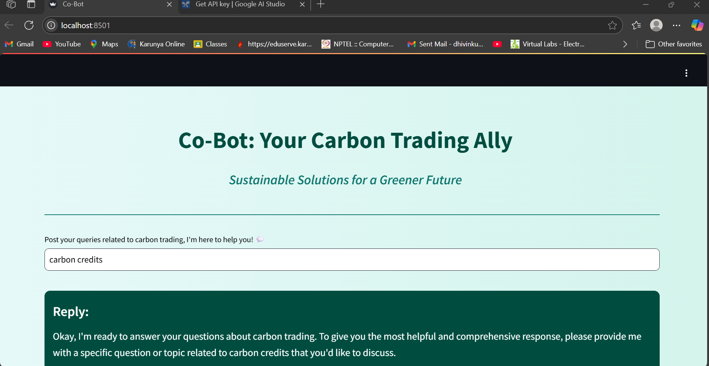
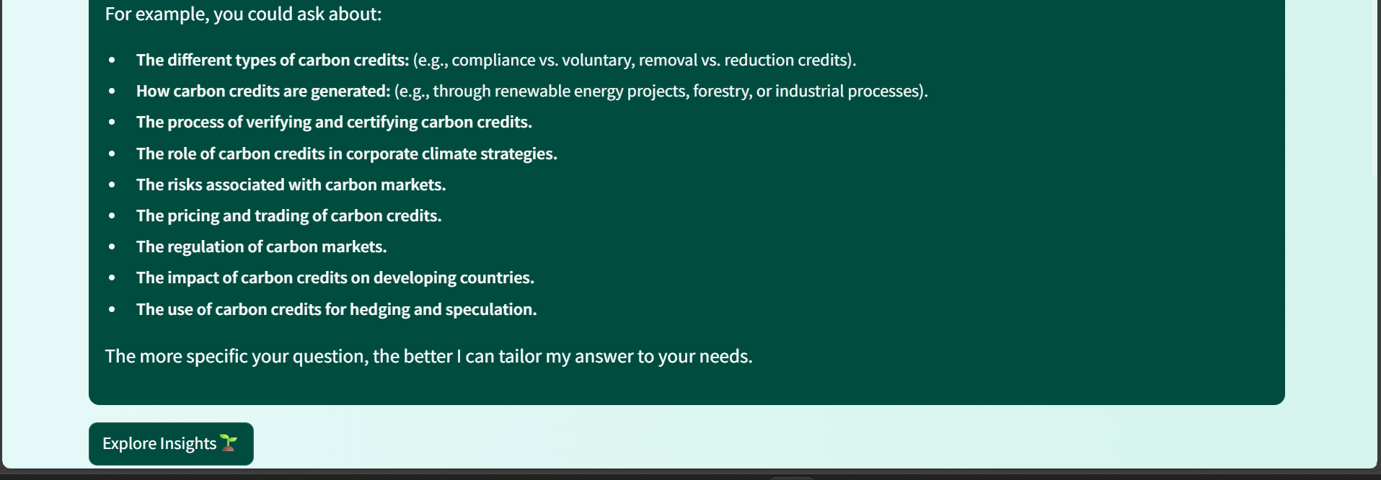

Slide 29
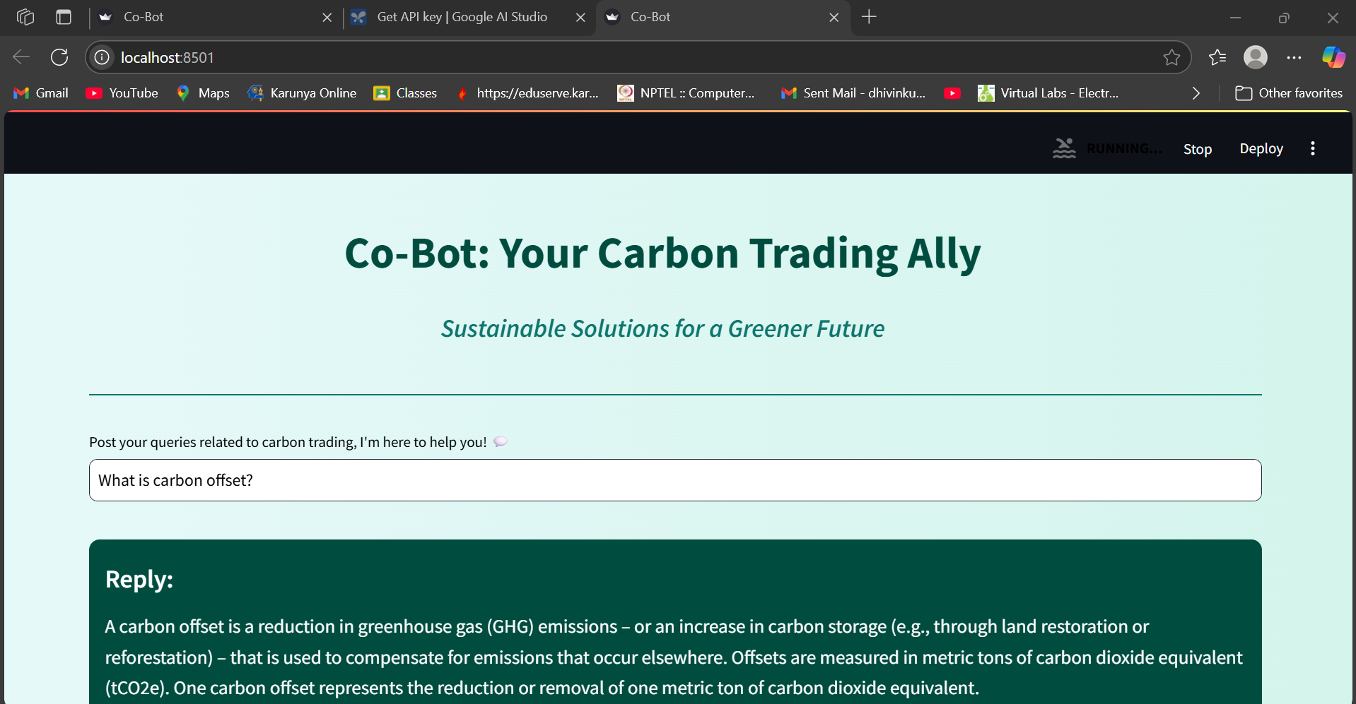
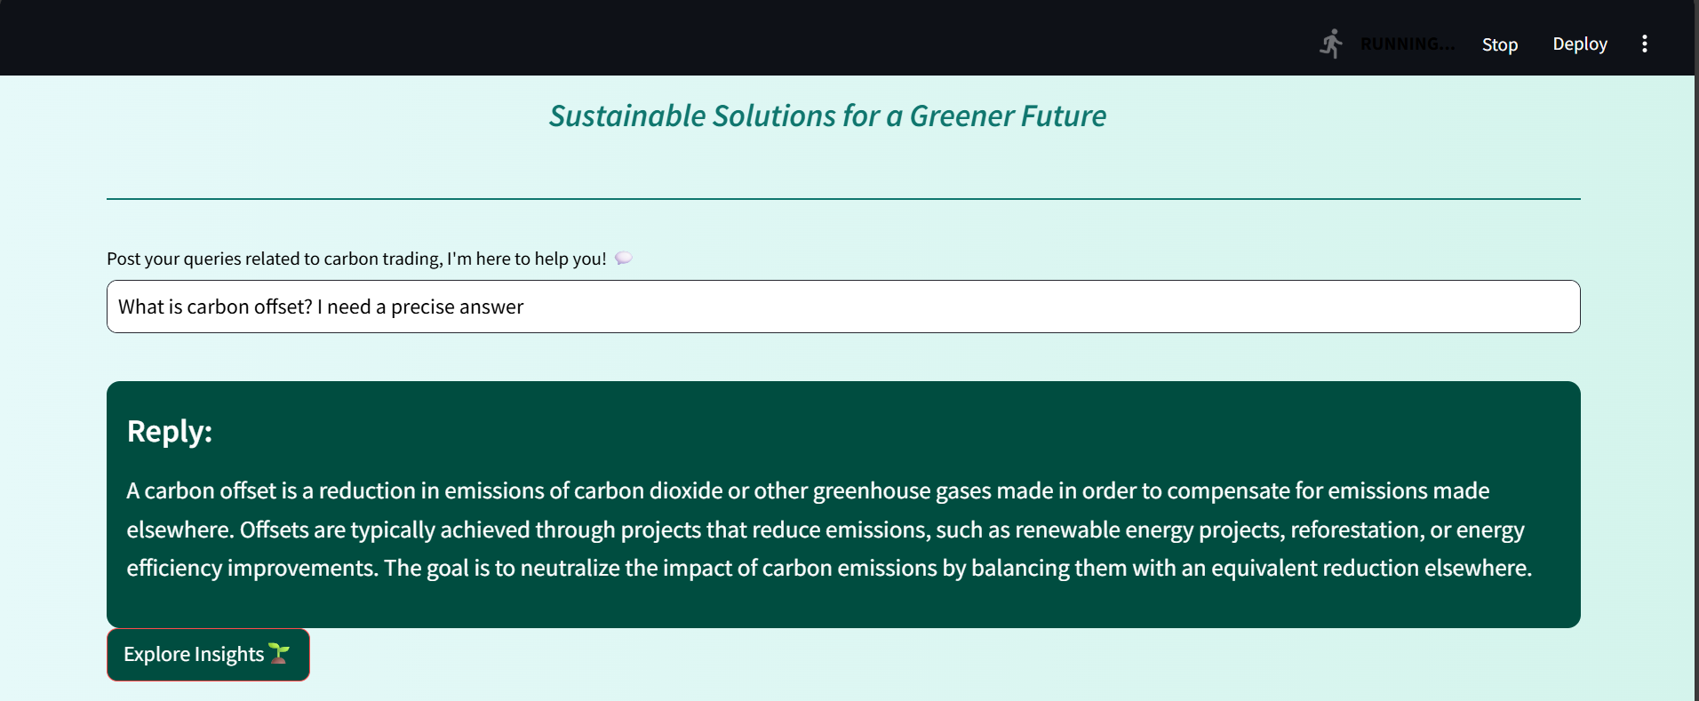
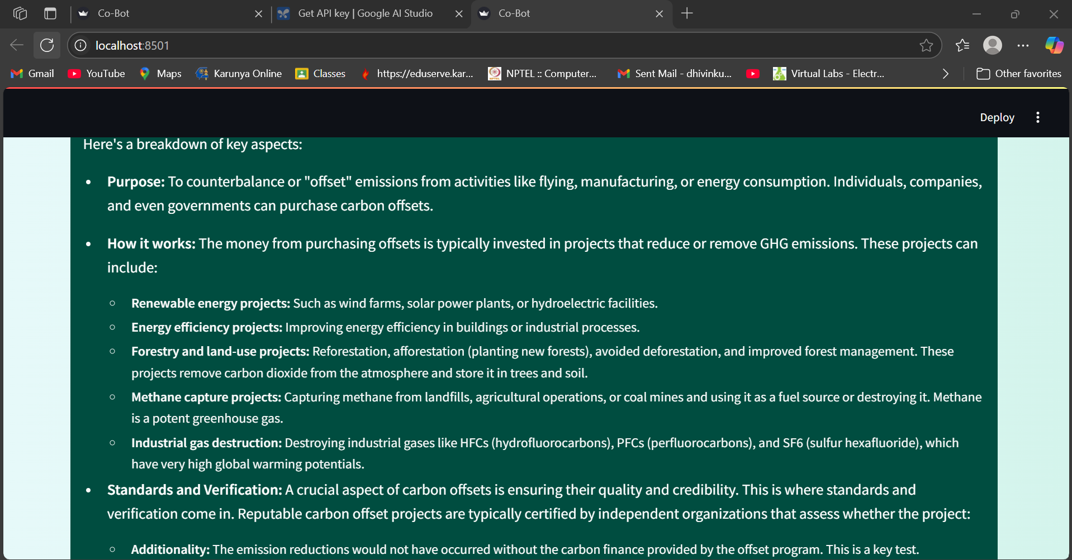
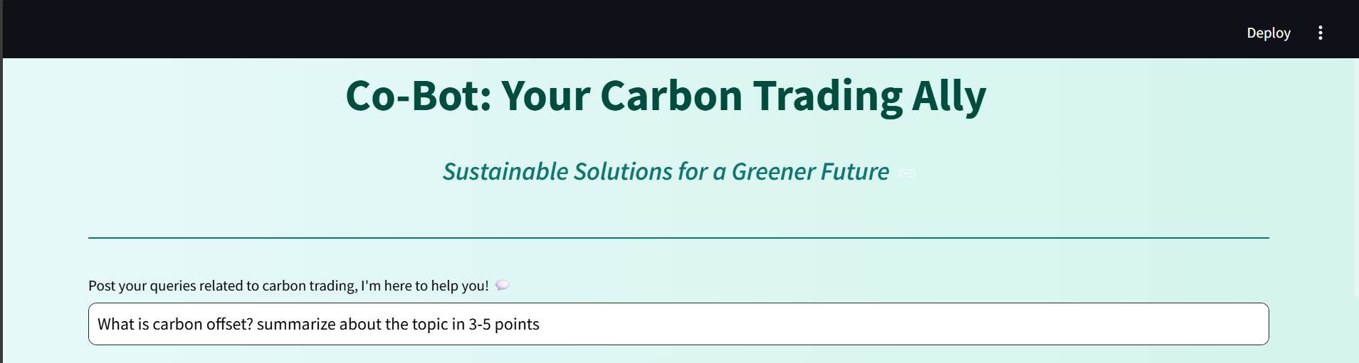
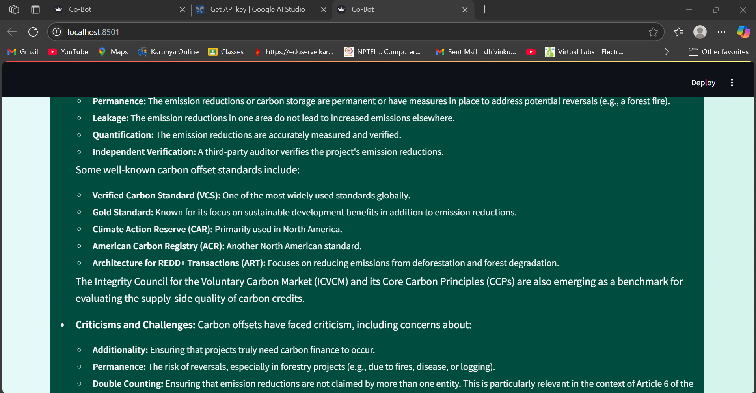
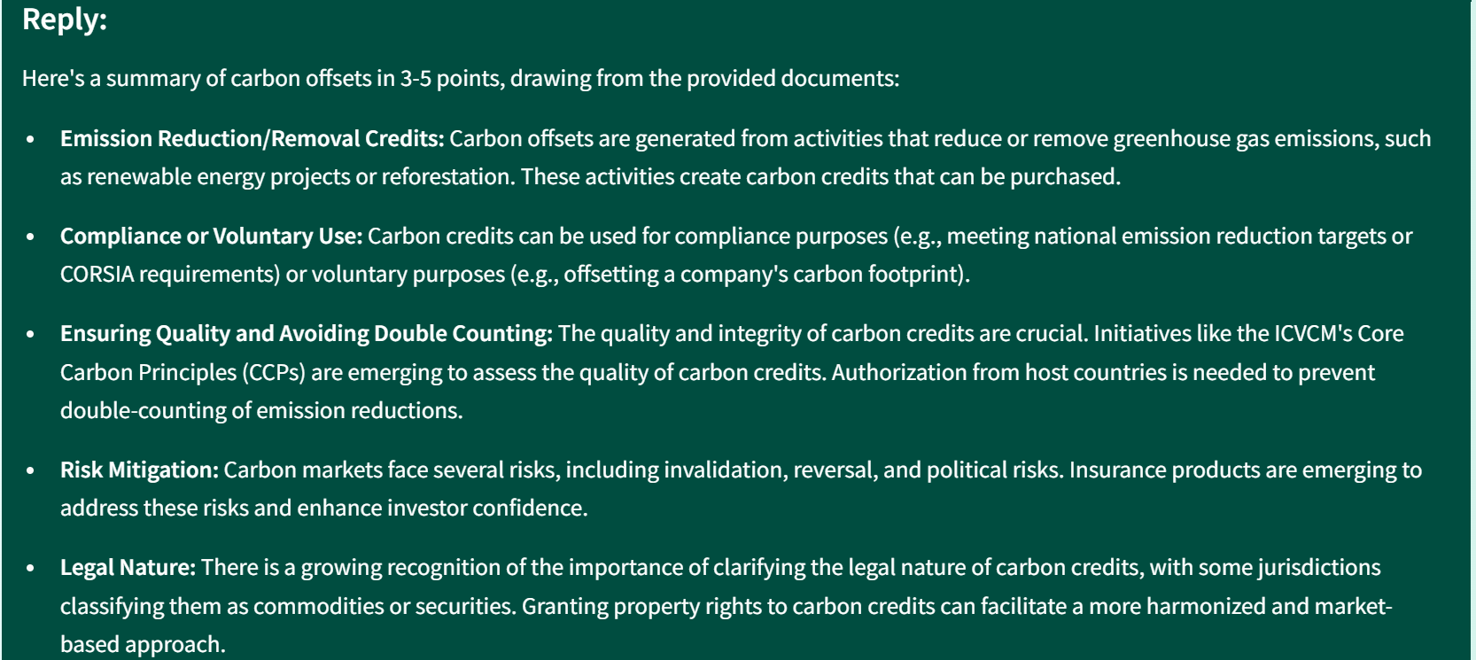
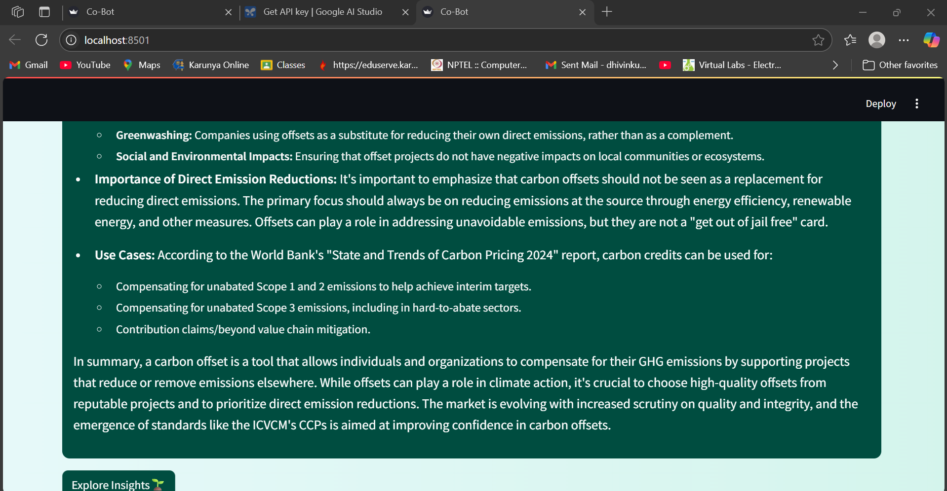

Slide 30
Future Enhancements:
Although CoBot shows that it can use a RAG-powered chatbot framework to respond to real-time carbon trading enquiries, there is still a lot of room for improvement to increase accuracy and operational reach. To improve the dynamic nature of responses, one of the main improvements is broadening the range of input sources, such as live databases, carbon pricing APIs, government policy repositories, and real-time emissions trackers.
By fine-tuning the language model on domain-specific corpora like UNFCC protocols, trading registries, and verified ESG reports, contextual understanding can be further enhanced. This would improve the chatbot's capacity to manage intricate, multi-intent enquiries involving subtle regulatory differences or comparisons across markets.
The system may become available to a worldwide audience by incorporating multilingual support, particularly for stakeholders in carbon markets where English is not the primary language.
Technically speaking, system updates could be streamlined by automated document ingestion through user uploads or URL fetch. Over time, real-world applicability may be improved by a mobile version or deployment on embedded systems (like edge devices in regulatory offices). Including feedback learning loops and usage analytics could aid in the model's ongoing adaptation to guarantee scalability and sustainability. CoBot can develop into a comprehensive, real-time decision support tool for stakeholders in the global carbon market with these improvements.

Slide 31
References:
Cao, Z., Han, M., Wang, J., & Jia, M. (2025). CarbonChat: Large language model-based corporate carbon emission analysis and climate knowledge Q&A system. arXiv. https://doi.org/10.48550/arxiv.2501.02031
Vidivelli, S., Manikandan, R., & Dharunbalaji, A. (2024). Efficiency-driven custom chatbot development: Unleashing LangChain, RAG, and performance-optimized LLM fusion. CMC–Computers, Materials & Continua.
Raymond, L. (2024). Carbon trading. In Edward Elgar Publishing (Book chapter).
Mustafa, B. S., & Madhi, Y. E. (2024). LLM and RAG powered chatbot for the College of Computer Science and Mathematics at the University of Mosul. International Research Journal of Innovations in Engineering and Technology.
Jiang, P., Sonne, C., Li, W., You, F., & You, S. (2024). Preventing the immense increase in the life-cycle energy and carbon footprints of LLM-powered intelligent chatbots. Engineering, Elsevier.

